Slide 1
Jumping the Fence: Improving Jump Oriented Programming Tools
John Dunlap

Slide 2
Who am I?
John Dunlap
Gotham Digital Science
@johndunlap2
Exploit developer, reverse engineer, security researcher, penetration tester with emphasis on static analysis and code review
Fan of assembly language of all flavors
Avid Demoscene enthusiast
Play too much counterstrike

Slide 3
What is JOP?
A variation of Return Oriented Programming
https://repository.lib.ncsu.edu/bitstream/handle/1840.4/4135/TR-2010-8.pdf?sequence=1&isAllowed=y
First described in 2010 by a group at North Carolina State University
The technique described in the original paper is not often used in public exploits.

Slide 4
What are we here to talk about?
Potential improvements to help ROP compilers support JOP development
Adding additional architecture support to the current compilers, and figuring out which architectures will benefit most from the technique
Applying modern ROP generation techniques to JOP

Slide 5
Explaining Return Oriented Programming
Method of bypassing Data Execution Prevention
Code from the text section is pointed to by an attacker controlled stack, and then control flow is returned to by the RET instruction
In this way, the restrictions on the executable stack can be bypassed by attackers.
Limited to the class of situations where the attacker controls the stack, and has the power to place a list of return addresses there.

Slide 6
JOP
Jump Oriented Programming allows for exploits which are not strictly dependent on control of the stack.
Instead, a dispatch gadget exists which can jump to a table of instructions ending in “JMP”
Because we are repeatedly JMPing back into our dispatch gadget instead of returning to the stack, stack control is no longer a necessity, besides the code it will require to initially JMP into the dispatch table.
This means if we strike out with ROP, we may have a large number of JMP payloads to work with
This also opens up new places to look for gadgets.

Slide 7
Why JOP?
We don’t always have stack control.
Stack based exploits are in the sights of exploit mitigation systems.
Intel Shadow Stack
Stack pivots are hard to find, and limit the effectiveness of stack based exploits.
Stack pivots are dangerous in Kernel space
Protections like SMAP/PAN and other stack protections make the stack unattractive on some platforms
Stack canaries are a pain
It is often more convenient to use other registers than the SP as our shellcode PC
JOP opens up the way for interesting and unusual shellcode patterns.

Slide 8
In Depth Explanation
Graphic Bletsch, Jiang, Freech et all

Slide 9
Dispatcher
Provides control flow
Main requirement is to “iterate” the program counter for the shellcode, i.e add edx, 4 JMP [edx]
The choice of the dispatch table constrains the choice of gadgets from here on out. Gadgets must be able to somehow return to the dispatcher gadget.
This means that each potential gadget type must be chosen within the context of the dispatcher gadget.
Usually this means controlling the value of a register which has to hold and continue holding the address of the dispatch table.
Selected gadgets cannot corrupt the register holding the location of the dispatch table, or must somehow account for this corruption.
These complexities are usually left for the exploit developer to handle.

Slide 10
Dispatch Gadgets Continued
The most straight forward designs involve “adding” to a register which is iterated, however other less direct schemes are available.
Any predictable pattern will do, the limit is based on what we can provide in shell code.
Memory deference options are also I.E EAX = *EAX-4 – imagine your shell code is oriented as a linked list of memory locations rather than an area.
This opens the door for many data structures, and reuse of many existing structures.
The constraining factor appears to be sufficient control of registers to save the “program counter” and a place to save the location of the dispatcher gadget. Attackers can get creative in terms of ways to hold onto the location of the dispatcher gadget.
It is also viable option to switch dispatch tables mid exploit as it suits the purposes of the exploit.

Slide 11
Functional Gadgets
Has to do something
Has to jump back to dispatcher gadget
E.G jmp edx or Jmp [edx]
More complex options are possible e.g jmp [edx+esi*4-1]

Slide 12
Basic Gadget Flavors
Data Loaders: Many protections are against using the stack for control flow, We can still potentially use the stack for loading data.
Memory Access: Loader, Storing from memory.
Arithmetic and Logic: Add, Sub,
Branching
System Calls
Register Cleaning (important and sometimes tricky in practice!)
All of this will depend on the nature of our dispatch table.

Slide 13
Current Tools
ROPGadget
Mona.py
Ropc
Ropper
Radare2

Slide 14
Issues to Consider: Basic Support
ROP Gadget location tools each support searching for JMP instructions.
Development is sped up from manual reverse engineering efforts, but identifying potential dispatcher gadgets is left as an exercise to for the reader
Important functionality, like standard payloads (e.g memprotect calls in Libc) are not easily retrieved.
Much work identifying and ordering gadgets is left to the exploit developer.
On small to medium sized binaries, not many gadgets are found.
The tools do not vet gadgets in any way – many gadgets are useless.

Slide 15
Issues to Consider: Architecture Support
Jump Oriented Programming is very useful on embedded platforms where stack control may not be easy to come by.
Or there is no stack!
Any platform which which attempts to introspect the callstack to maintain control flow may benefit from JMP oriented programming.
However, ROP tools typically only support a handful of the most common architecture choices. Options beyond x86, ARM, and MIPS are often hard to come by.
Except Radare, that supports everything under the sun.

Slide 16
Architecture Support in Popular ROP Gadget Tools
Tool | Supported Arch | JMP Supported Arch
Ropper | x86,x86_64,MIPS/65,ARM,ARM64,PPC | x86,x86_64,MIPS/65,ARM,ARM64,PPC
RopGadget | x86,x86_64,MIPS/65,ARM,ARM64,PPC, SPARC, MIPS | x86
Mona.Py | x86 | X86

Slide 17
Radare
Radare2 has a very generic ROP functionality to find gadgets, which can support just about any set of assembly instructions.
Has a great deal of architecture support.
This is balanced by the fact that R2 is a little complex to use, especially for this purpose.
Supports AVR
Has a robust gadget search feature
No automated chains for virtual protect or other common payloads

Slide 18
Actual Functionality Provided
In all cases, the tools are meant to look for JMP gadgets, but not dispatch tables specifically (which would be a subset of all gadgets)
Gadgets are hardcoded into place, and a limited number are provided in each tool.
Support for actual DEP bypassing payloads is varied, but generally lacking. You’re kind of on your own.
Generally, pre-existing payloads for known linked libraries are not present.
These problems are compounded in the less popular architectures.

Slide 19
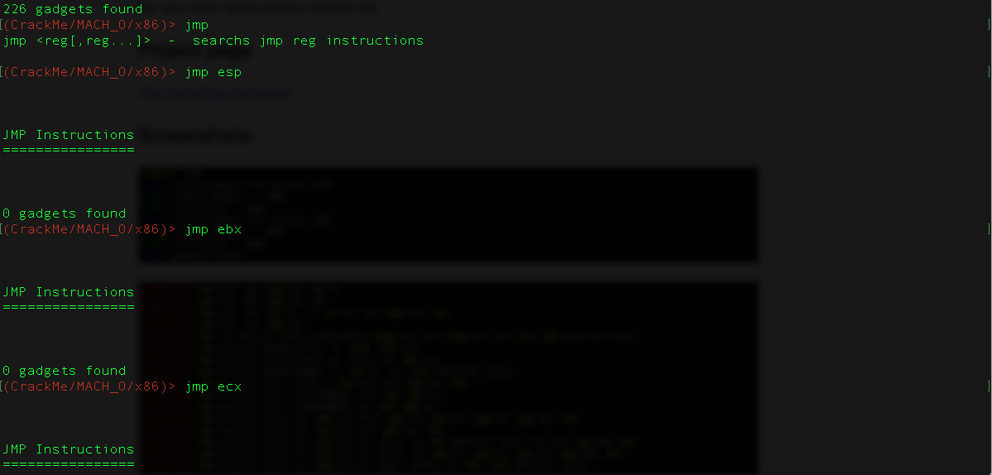
Ropper
Some issues finding JMP gadgets on smaller binaries…

Slide 20
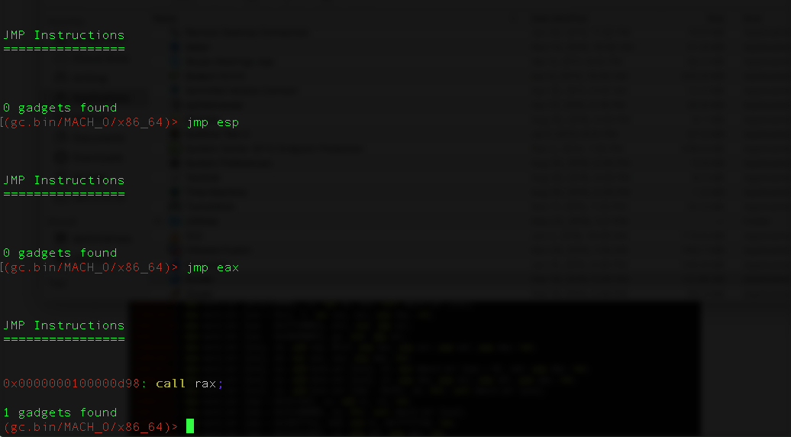
Ropper Cont.
Somewhat better results searching through Google Chrome.
Ropper does not appear to search through linked libraries. That would be a time saver!
Just found one gadget!

Slide 21
Ropper Cont
Better performance on a much larger binary
Still leaves us with homework to do

Slide 22
Ropper Cont
Good number of gadgets found.
We can filter by register – that kind of helps.
However, all we get are the addresses of the gadgets, no match up to known payloads, Gadget types, or the context of gadgets.
User is left to put together the pieces.
A JOPChain feature similar to the ROPChain feature would be awesome!

Slide 23
Ropgadget
More is found in the Google Chrome main binary, but still not quite ideal.

Slide 24
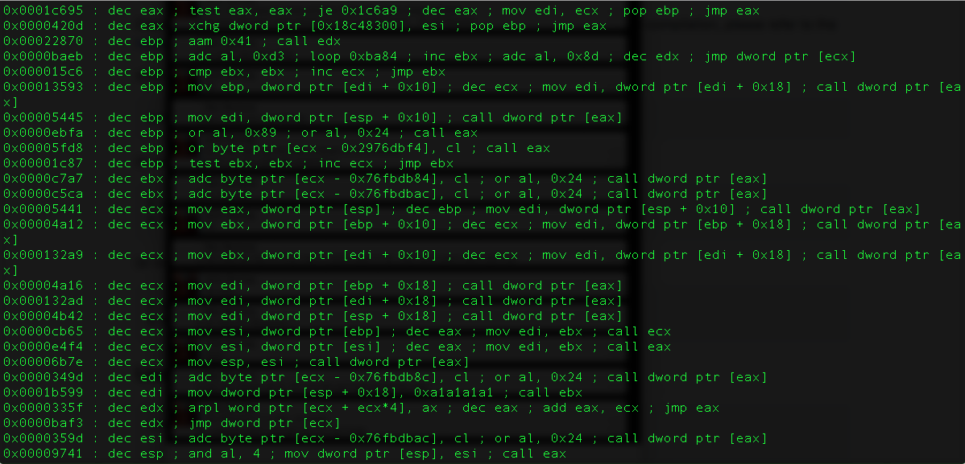
ROPGadget
Against LibObjectiveC we find much more

Slide 25
Mona.py

Slide 26
Mona.py
More options.
More targeted approach – simple JMP gadget search, and a search for specific useful JOP gadgets.
Loads linked libraries and checks them for ASLR/DEP – big deal!
Is not able to create a fully realized payload the way that the similarly excellent ROP modules can. No out of the box ASLR bypass!
No real 64bit support

Slide 27
General Issues
Lack of gadgets: Each tool only looks for JMP/CALL. Very large binaries are required to build a whole payload this way.
Analysis overhead: The exploit developer is forced review each gadget manually and determine it’s potential function.
Very little help finding “dispatch” gadgets.
No help linking dispatch gadgets to useful gadgets.
Ultimately producing a DEP bypass with any of the tools is a painstaking manual process which hinges on a the binary have a huge number of JMP or CALL instructions.

Slide 28
Improving Basic Gadget Search
Add more potential gadget opcodes
Ensure that the current tools find all the gadgets they are supposed to
Look for opportunities in misaligned or otherwise invalid instructions
Find opportunities where the tool may consider a CONDITIONAL jump a non-conditional jump. Conditional jumps are often placed after “sanity check” code like “if (fileOpened){“ – these JMPs can be added to the list of candidates but must be vetted somehow.

Slide 29
Gadget Search Improvements - Ropper
Searches by hardcoded opcodes based on a hardcoded list of registers.
Context of the gadget is not given
Ensured that “misaligned” instructions are searched for:
This was hard to accomplish in Ropper, and ultimately of limited use – see later in the talk for more on that.
General purpose registers r8-r15 not included in this list.
R8-R15 Support added in for JMP and CALL instructions
Also added support for jmp [rax] and call [rax]
Curious Question: Can you jump to a SIMD register? You shouldn’t be able to…
No, but it’s a fun thought.
Someone needs to think exploit schenanigans with SIMD registers, I like the things.

Slide 30
Gadget Search Improvements – Rop Gadget
Capstone once again
Slightly different approach to coding but essentially the same results.
Already supports R8-R-12 and [eax] style gadgets.
Not much to add in terms of current X86-64 support.

Slide 31
Gadget Search – Mona.py
Mona.py is a single 20k python file.
With really good code!
Doesn’t search for R8-R15 registers in gadget search
This would be easy to add in theory based on the code.
Unfortunately Mona.py doesn’t analyze x64 binaries : (
“It will require some work to make both mona.py and windbglib compatible with x64”
A project for a different day, sadly.
Great implementation of a virtual protect DEP defeating gadget search! It would be awesome if there was a JMP only version.
Sadly, we are tied down to windbg or immunity debugger. This means we can’t work in a purely static context.

Slide 32
Improving Gadget Comprehension
Reading a few instructions behind the jump and marking instructions with relevant properties would help the exploit developer. Think JMP ESP or POP POP RET – ADD EAX JMP EAX is a useful gadget.
This is often accomplished in current ROP compilers by searching the disassembled instructions for relevant mnemonics.
A VM like Unicorn would be better
Do this for the possible “data structures” with Jump oriented programming.
Gadgets can be classified in similar ways to ROP gadgets i.e add, subtract, CALL REG, zero REG
Common compiler idioms can be used to help search for these
Some types of code / compilers are more or less likely to put out lots of unconditional jumps. Unconditional jumps may not exist in great enough abundance to accomplish the technique
Understanding that a conditional JMP is actually not conditional in the context of the attack would be a huge help.

Slide 33
Gadget Comprehension Strategies
Grepping mnemonics
Watching for certain opcodes
VM based techniques

Slide 34
Related: Considering Conditional Jumps
Actually most jumps the compiler puts out are conditional. This actually makes sense, since there is a lot more IF THEN than GO TO.
However some conditional jumps can be relied upon always evaluating true
Moreover, some gadgets can be forced to evaluate true with minimal register control.
Being able to automatically identify even a fraction of conditional jumps in the binary which fit these criteria would be a large advantage
This may depend on the state of registers, the stack and other factors.
A lightweight VM may help figuring these things out.
Being able to detect gadgets not affected by outside state would be optimal.

Slide 35
More Issues with Using Conditional Jumps
On x86 all conditional jumps are relative.
Compilers commonly a pattern where a conditional jump is more like a gatekeeper for a non-conditional jump.

Slide 36
Example

Slide 37
Consequences/Workarounds
Can’t use the conditional jumps for creating the dispatch table itself, however the conditional jumps might be used for other control flow manipulation.
Useful code may lay adjacent to conditional jumps. The conditional jumps may be influenced by manipulating the FLAGs register before jumping into the gadget.
Solution: Flip the FLAG’s register in the emulator and check the results.
Check final address for register based control.

Slide 38
Unidiff Output

Slide 39
Classifying Gadgets with the VM
All Gadgets in the dispatch table require two abilities: modify a register, and jump to a predictable location.
Unidiff points out and rates gadgets that 1) jump to a user controllable location (register in most cases) 2) perform some kind of mutation on the registers.

Slide 40
Gadget Comprehension Example with Unicorn VM
Very short dmeo!

Slide 41
Table Traversal
User Controllable register
Mutate Value (E.G add EAX,0x1)
Jump to register

Slide 42
Unidiff Finds It

Slide 43
Functional Gadgets
Mutate controlled Register (Not P.C!)
Try not to destroy any other registers
Jump back to the table

Slide 44
Unidiff Finds It

Slide 45
Approaches to Gadget Composition
Once we are able to identify a dispatch gadget than we can start to reason how we can put the whole thing together automatically.
Building a simple payload that reliably does something like increment a register works.
Ultimate goal to automatically construct a dep bypass.

Slide 46
Corelan’s ROP Algorithm from Mona.py
Corelan’s Mona’py sets up ROP payloads to disable DEP very well
His strategy is to start with a list of effects on registers he wants to implement i.e EAX = some value
Tries to minimize worrying about side affects by jumping a limited number of instructions from the RETURN
Does not fully consider the side affects of the gadgets. Sometimes the exploit developer has to modify the generated chain by hand.
Relatively simple, effective, and easy to implement.
Very portable, no dependencies besides the existence of Immunity/WinDbg
While this was the most straight forward technique to implement, I am saving it for another day.

Slide 47
Mona.py

Slide 48
Technique: SMT Solver and Emulator
By using a lightweight emulator we can figure out the side effects of the gadgets by running them. It wont be perfect unless we specify the exact initial state of the CPU.
From here we can use a constraint Solver like Z3 to figure out the chain.
Techniques like this have been tried for ROP exploits, but no one has specifically updated them to take advantage of the JOP technique.
The catch: Super CPU intensive, slow, seems to fail in more complex situations.
Providing known values helps the solver a bit
https://github.com/kokjo/universalrop is an existing implementation for ROP
Additions:
Had to make the engine aware of memory locations without making the problem unsolvable or give irrelevant answers.
Had to setup the initial state with the attacker controlled register pointing at the attacker controlled memory.
It would be ideal for solver to be able to figure that out

Slide 49
Architectures to Consider / Adding
ARM – ARM support is important for JMPs, but the tools don’t do much to help you reason about ARM based exploits.
AVR – highly useful, but ROP chain generated tools generally don’t support it. ROP/JOP is basically the only option for exploitation due to the Harvard architecture.
z\OS – Available with Capstone. Why not?
Because ZOS assembly language is the “dark souls” of assembly language flavors. 31 Byte architecture.
Alright it’s not actually that bad.
SPARC – Available with Capstone too.
I added this to Ropper
In general, Alternative X86 modes (Real mode, for instance) are not explicitly supported. While some encoding will be the same, other useful instruction encodings may be ignored by the tools.
Lots of encodings to consider!

Slide 50
ARM Support
Due to the nature of “returning” to the stack ARM ROP gadget tools tend to look for very specific instructions “bx lr / pop PC”

Slide 51
Adding New Architecture Support: AVR
Adding any capstone supported architecture in capstone based tools shouldn’t be an issue…. In theory
Except no Capstone support for AVR!
I seriously considered just writing a disassembler when I read that for the first time.

Slide 52
The Current State of AVR Disassembler Framworks
something lighter….
Looks like the Radare guys had to write their own disassembler.
Basically re-implementations of Objdump/Binwalk
https://github.com/vsergeev/vavrdisasm
What we’d really like is an API for this sort of thing.
Maybe someday someone will add AVR support for capstone.
Radare2 has a bespoke disassembler for this.

Slide 53
How about Sparc?
Arguably the least useful.
On the other hand traditional “return oriented programming” is odd on SPARC due to the fact that RETL is a synthetic instruction
Nonetheless, due to the behavior of SPARC compilers, you are unlikely to have enough gadgets anyway.
It appears many binaries use unconditional JMPS infrequently, and with only one register at that. I.E “JMP %g4” may be the only command that’s ever used.
SPARC, so JOP is really the only way to go.
But hey why not?
Added same functionality present in Ropper/Ropgadget
Added support for JUMPL
CALL is not useful for JOP here because it only takes hardcoded addressed, not registers.
Didn’t have time to parse out all the SPARC flavors.
Capstone doesn’t have an option for this
A matter of figuring out the encodings
81C0/1[REG] essentially
Actually a good bit more complicated, but this kinda works.
Tested against the LLVM frontend binaries for SPARC

Slide 54
Sparc Encoding Example
Sparc9 architecture Manual

Slide 55
Overview
We found some points of improvement in common JMP tools
Architecture support
Included Opcodes
Gadget identification
Gadget Composition
We added some architecture support
Sparc
z\OS
AVR
We started work on a tool to help exploit developers create JMP oriented programming exploits more easily.

Slide 56
Ideas for the Future
More architectures
Integrating Concolic execution techniques
More “known” payloads for non-aslr libraries
Better support for Kernel JOP
Tools with more expressive control of the JMP gadget “data structure”

